Slide 1
Paper Flow
Partitioning our System

Slide 2
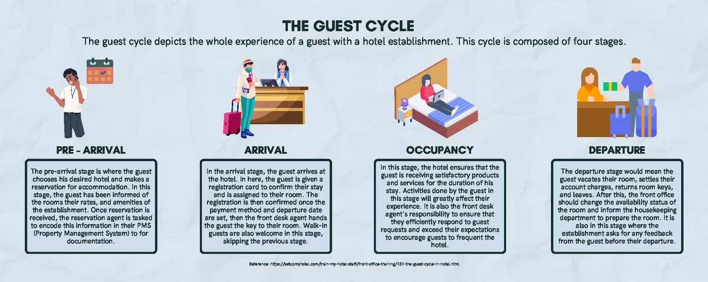

Slide 3
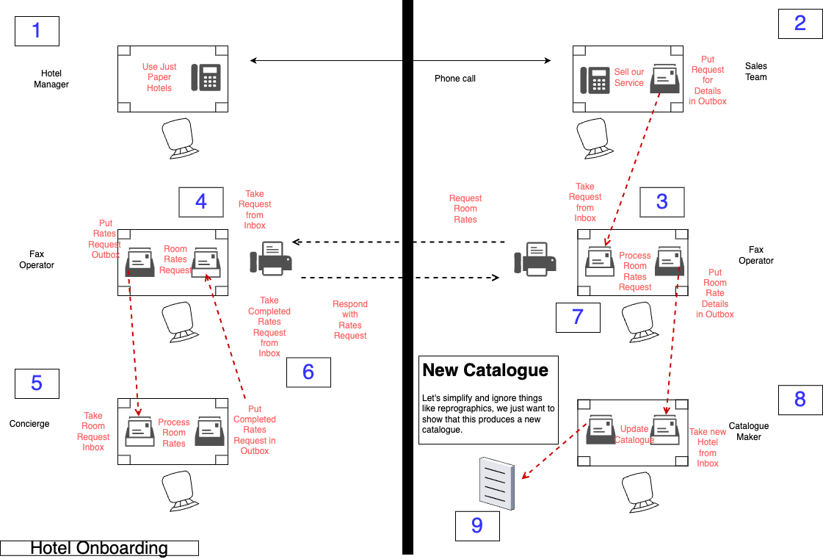

Slide 4
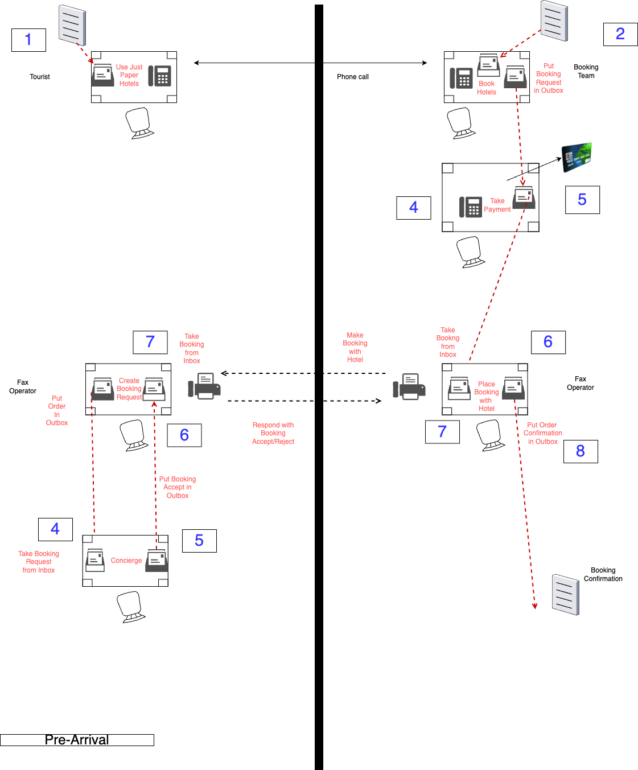

Slide 5
